Slide 1


Slide 2
REC THERAPY FOR CHILDREN
(AGES 7 TO 12) WITH ABUSE-REACTIVE NEEDS AT A RESIDENTIAL PSYCHIATRIC TREATMENT FACILITY
Monday, Sept. 12th, 2016
10:00 a.m.
ATRA Conference

Slide 3
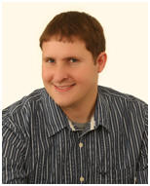
Rec Therapy for Children with Abuse-Reactive Needs
Presented by:
Danny Pettry
M.Ed., M.S., LPC, NCC, CTRS,
A Lifetime Member of ATRA
Important: Got questions? Write them down and email me at my personal email: Danny@DannyPettry.com – I’ll reply. I might not see your question in the inbox in this webinar and wouldn’t leave you out.

Slide 4
Here is My Promise To You:
By the end of this session, you’ll know three (3) types of therapy models for helping children with abuse-reactive needs.

Slide 5
This session will provide you with some really helpful tips for helping children with abuse-reactive needs.

Slide 6
You’ll get a lot of information
If you stay until the end of this session.

Slide 7
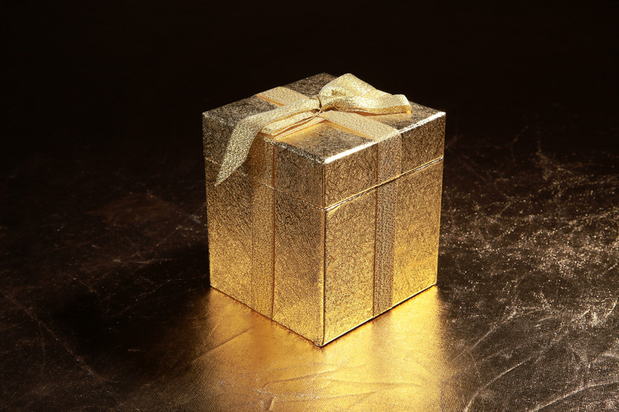
And If You Stay Until The End...
I’m going to give you several gifts!

Slide 8

Gift # 1
A discount for my online continuing education program for Recreational Therapists with emphasis on children needs.

Slide 9
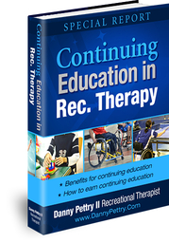
Gift # 2
My Special Report on Continuing Education in Rec. Therapy

Slide 10
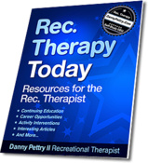
Gift # 3
Access to my Rec Therapy Today e-newsletter

Slide 11
My activity ebooks
You can easily print out pages. They are children-focused:
  Exploring emotions through Activities
  Learning about leisure through Activities
  Fun ways to stay fit through Activities
  Building social skills through Activities

Slide 12





Slide 13

Need Your Attention Please...

Slide 14
I Need Your Attention Please...
Turn off cell phones
Turn off Facebook
If you're a Recreational Therapist and you’re serious about helping children to make positive character choices… then you’re going to want to stay focused…

Slide 15
Why is it good to stay focused?
It makes you smarter
I was recently reading, Dan Hurley’s book: Smarter.
One of the tips was being focused on one thing/ being mindful.
Author, Tim Ferris had a blog entry that said multi-tasking kills brain cells.

Slide 16
Who Are You!
I want to know who you are!
Type in the box how you work with children: in example: at a hospital, as a parent, as a teacher, or rec therapy in schools, etc. Let me know.
What do you hope to learn or gain form this session.

Slide 17
You might be asking yourself:
Who is Danny Pettry?
Why is he qualified to present this session?

Slide 18
I want to briefly discuss my credentials
And Then I want to tell you everything I know about trauma-informed care for children.

Slide 19
Who is Danny Pettry?
Professional Practitioner
  Completed undergraduate internship (in 2002) with adults and seniors for an acute-care psychiatric unit at a medical center.
  First job offer (Aug. 2002) was providing services for children with abuse-reactive needs. I’ve worked there ever since.

Slide 20
About the kids
The kids in this program have had some type of abuse: physical, emotional, sexual, neglect, witness to violence.
These kids have reactive behaviors that consist of: physical aggression, verbal aggression, sometimes sexual acting out behavior, and other self-destructive behaviors.

Slide 21
My Qualifications
I maintained full-time employment while completing two graduate degrees!
  M.S. Recreational Therapy, Indiana University, 2006, where I studied with Dr. David Austin.
  M.Ed. Mental Health Counseling, Lindsey Wilson College, 2012

Slide 22
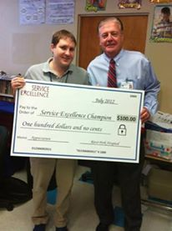
My Awards
Employee of the month several times

Slide 23
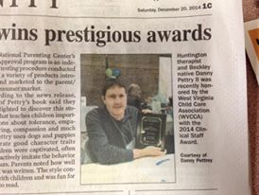
2014 Practitioner of the Year by Child Life Association

Slide 24
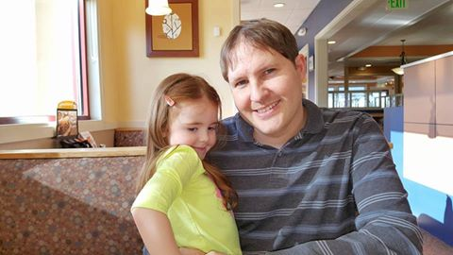
My real qualification

Slide 25
Credentials
Certified Therapeutic Recreation Specialist (CTRS) since 2003
National Certified Counselor (NCC) since 2013.
I am a Licensed Professional Counselor (LPC) in a state that does not license rec therapists yet.

Slide 26

Okay that is way too much about information about me.
Because This Session is About YOU and providing you with tips to help children who’ve experienced trauma

Slide 27

Today - you’ll discover what you need to know about trauma-focused Care

Slide 28
RESULTS! / PROOF!
Evidenced-based practices
What works
The models provided today are grounded in evidence.

Slide 29
What We'll Cover:
Introduction: About the Child with Trauma
Part # 1: Trauma-Focused Cognitive Behavior Therapy (TF-CBT)
Part # 2: Dialectical Behavior Therapy (DBT)
Part # 3: Humanistic Approach
Outcomes: A Healthier Functioning Child!

Slide 30

Introduction:
About the Child with Trauma

Slide 31
Children
My belief:
  All children are good. Charlie Appelstein has a book, “No Such Thing as a Bad Child.”
  Children are born wonderful human beings with the potential to do great things with their life!

Slide 32
And Sometimes…
Bad Things Happen in the child’s life that mess them up.
What is the bad thing?
  Child abuse, neglect, major loss, sexual abuse, domestic violence, verbal and emotional abuse, war, and other major life struggles.

Slide 33
The soldier returning from war
If is often easier to understand that a soldier returning from war has struggles from their traumatic experiences. Some soldiers have “PTSD.”
Sometimes it is difficult to understand that children too can have PTSD too.

Slide 34
The innocence of children
One child had written a note to her mental health therapist and had written To: Laura, M.A., LPC, RPT, NCC, ALPS and then signed it with her name [Jenny,not real name] ADHD, ODD, PTSD. She thought all people had letters.
OR driving by coal power plant and a girl saying: that is where they make clouds for us

Slide 35
The Better Question
Don’t ask: What is wrong with that child?
Do ask: What happened to you?

Slide 36
Assessments
Trauma Symptom Checklist for Children (TSCC) is often used by mental health counselors. It is valid way to determine symptoms. Six clinical scales: Anxiety, Depression, Posttraumatic Stress, Sexual Concerns, Dissociation, and Anger.

Slide 37
Rec Therapy Focused
Read reports in Medical Records/ patient history (so you won’t trigger by accident). Of course, it will happen and you learn as you go.
Rec Therapy assessment covers: social, emotional, cognitive, physical, and (previously leisure) now functioning.
Strength-based – what is working – build on it

Slide 38
Part # 1:
Trauma-Focused Cognitive Behavior Therapy

Slide 39
TF-CBT
There is an easy-acronym for this model.
It is: PRACTICE

Slide 40
PRACTICE
P - Psycho-education about trauma
R – Relaxation skills training
A – Affect regulation skills
C – Cognitive Processing skills
T – Trauma Narrative
I – In-vivo
C – Conjoint family therapy
E – Enhancing safety skills and social skills

Slide 41
Psycho-education
Teach the symptoms of trauma.
Let the child know it is not her (or his fault)
Let them know about the good news – that therapy (TF-CBT) has shown to help!
A Terrible Thing Happened by Margaret Holmes is a book I read

Slide 42

The book

Slide 43
Relaxation Skills Training
This is major recreational therapy ideas:
Hobbies, music, sports, yoga, imagery, progressive muscle relaxation (PMR), deep breathing, music, (See DBT skills in next section).
Relaxation cards game!
Animal Yoga Cards

Slide 44
Relaxation skills
Healthy distraction to get mind away from dwelling on past or worrying about the future
PMR: kid friendly names – squeeze the lemons, tin man to rag doll, toes in the sand, mad face – relaxed face.

Slide 45
Affect Regulation Skills Training
Learn to identify more feelings.
IT is okay to feel all feelings.
Create emotion cards – how many can you identify
Then ask to share aloud what was going on with each emotion.

Slide 46
Monster emotions
Poster was created by a rec therapist.
Of course facial expressions work
Use pictures from newspapers or magazines with cut out faces

Slide 47
Play therapy – color my heart
List emotions. Add a color for each emotion (like a key) blue could be sad or red could be angry – let kid pick colors for emotions. Good for assessment and evaluation.

Slide 48
Emotions intensity
Scale 1 to 10
How to bring it down a notch or two

Slide 49

My favorite book for Emo. Reg.
Blue Day Book

Slide 50
Cognitive Processing Skills

Slide 51
Identify Faulty Thinking
Help the child to make healthier changes with:
  Thoughts
  Feelings
  Behaviors
  People can control those three things.
  Some radical acceptance about what you can’t control – like the past. Or other people.

Slide 52
Trauma Narrative
This is the hardest part of therapy
The child tells his (or her) story.
Complete autonomy.
Sometimes this process starts to leak out in rec therapy – self-expression groups.

Slide 53
Autonomy
Write a book
Set it up in sandbox tray and take photos
Act it out – drama
Make a comic book
And other creative ideas
Collages

Slide 54
Five chapters of a TN
All about ME the wonderful kid
A positive memory or a super hero
The bad thing (or things) that happened to me
What I’ve learned in therapy
My hopes, wishes, and dreams for the future!

Slide 55
Never pressure
A child should not be forced into giving a trauma narrative because that could do more harm than good.
Most who complete one share aloud feelings of relief and freedom. It has therapeutic values.

Slide 56
In-Vivo Exposure
This involves identifying triggers.
May be returning home to a place where triggers occurred
And learn ways to use relaxation and cognitive processing skills (from earlier sessions)

Slide 57
Conjoint Sessions
Getting the child and caregiver (legal guardian) person she (or he) is returning (with mental health therapist)
Rec Therapist is often one going on community re-entry passes with the child and family member. Focus on trusted adult, support from adult. Identify concerns.

Slide 58
Enhancing Safety and Social Skills
What can you do if.. Situations
Simplyfun.com has a really neat key chain with safety skills questions/ and social skills questions. Works great.

Slide 59
Review
PRACTICE
  Psycho-education
  Relaxation
  Affect/ emotions regulation
  Cognitive processing
  TRAUMA Narrative
  In-vivo
  Conjoint Family
  Enhance safety skills and social skills

Slide 60
Part # 2:
Dialectical Behavior Therapy (DBT)

Slide 61
Developed by:
Marsha Linehan as a treatment for people with Borderline Personality Disorder.
Previously, in the DSM-IV, personality disorders fell under the Axis II as they were thought un-treatable.
The DSM-5 does not have Axis II. There are treatments for personality disorders- i.e. DBT

Slide 62
Dialectical
Two ends of a pole. Both could be right
  Planned a party – but people don’t have fun.
For teens, I like to play, Alanis Morissette’s “Isn’t it ironic.”
  Won lottery – died next day
  Good advice – didn’t take.

Slide 63
The focus
Creating a life worth living!

Slide 64
Validation is key
Validate that their emotions are real. Their experiences are real. Their suffering is real.

Slide 65
Four Main Skills are Taught
My internship supervisor in mental health counseling uses an acronym that one of her patients had created for the four skill-sets:
D: distress tolerance skills
I: interpersonal effectiveness skills
M: mindfulness meditation skills
E: Emotional regulation skills

Slide 66
Distress tolerance skills
Learn skills needed to cope with distress
Becoming more flexible
Acronyms like:
  IMPROVE
  Imagery, meaning, prayer, relaxation, one-thing-at-at-time, mini-vacation, encouragement (self and from others)

Slide 67
Interpersonal skills
People skills/ Assertiveness skills/ manners
  DEARMAN
    Describe the situation (facts only)
    Express emotions
    Ask assertively
    Reinforce the benefits
    Mindful – stay focused
    Act confident
    Negotiate

Slide 68
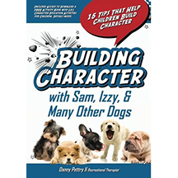
Teaching manners
This isn’t DBT, but I use my own book, Building Character to teach children basic banners.

Slide 69
The concept is
If you’re rude and disrespectful – it pushes people away.
Kind of a cycle:
They don’t like me – I’ll yell at them – they leave. I knew they didn’t like me – so, I’ll keep being mean to me. Why don’t they like me?

Slide 70
Mindfulness Meditation
Difficult concept to teach.
I’m still struggling.
I often call it FOCUS time for children.

Slide 71

Book that teaches Mindfulness

Slide 72
Focus
On the past: dwelling – feel bad.
On the future: dwelling – feel worried. ?
The focus is here and now. OF course a person could have rough feelings in the moment, but it would be a lot worse if you add the past problems and future worries to the moment.
Just do the moment – get through it.

Slide 73
Focus
Inside
  Your breathing
  Your heart-rate
  Your thoughts
  Your feelings
Outside
  Sights
  Sounds
  Smell
  Scents
  Sensations

Slide 74
Loss of Focus
It happens. Your mind will start to think of other things.
Someone said it was like training a puppy to sit still in one place – it will get up and go, but you return the puppy to place. – the same with your mind.
Don’t give yourself a hard time.

Slide 75
Sample
On a nature trail – great outdoor experience.
Focus on the moment – it is enjoyable. Nature smells nice. Beautiful colors. Awesome view. And my mind slips to progress notes or bills or family concerns or relationships and I’m like – okay back to relaxing in the moment.
Spend some time in nature! Smell the roses!

Slide 76
Emotional Regulation skills
Learning to cope with emotions
  ACCEPTS
    Activities
    Contribution
    Compare to worse
    Distract with opposite emotions – humor?
    Push away – put problem in a time-out box
    Distract with thoughts: puzzles
    Distract with sensations: using senses

Slide 77
Part # 3:
Humanistic Approach

Slide 78
Carl Rogers
He founded person-centered therapy.
It is a humanistic approach.
There are three concepts
  Be Real
  Empathetic listening/ validating
  Unconditional positive regard

Slide 79
Be the one
Be the “one” person who makes a difference.
Many people who got through a tough childhood attribute it to having at least one-person who cared and made a difference.
That could be you!

Slide 80
Be Real
It is about being authentic.
Nice can’t be faked.
Caring can’t be faked.
They will know it is faked.
Emotions match body expressions
  “You never get angry – you don’t know what it is like.” Self-disclosure time! Only if it helps the kid.

Slide 81
Empathetic listening/ validating
Pay attention.
Validate their emotions
Explore with questions.
Paraphrase from time to time

Slide 82
Unconditional Positive Regard
Hey kid – No matter what, I’m going to care about you. The truth – you’re going to mess up in the program. Maybe I’ll mess up too. But with you kid – I’m going to care about you no matter what.
Ethically – I don’t try to mess up.
Truth it happens:

Slide 83
Outcomes
A Healthier Functioning Child

Slide 84
What has the child gained?
Understanding of how trauma affected them
Relaxation skills to deal with it
Affect regulation skills to cope
Cognitive processing skills to change thoughts, feelings, and behaviors
Shared trauma narrative for therapeutic benefits
Developed people skills, interpersonal skills
Developed safety skills

Slide 85

Let me ask you a question...
Are you enjoying the webinar so far?

Slide 86
We've covered:
First: Trauma-focused Cognitive Behavior Therapy (TF-CBT)
Second: Dialectical Behavior Therapy (DBT);
Third: Humanistic Approach

Slide 87
So who wants to take things to the next level?
Say, "I'm ready!“
Say it louder!

Slide 88
Introducing:
Danny Pettry’s
Helping Kids
Self-Study CEU Bundle Program

Slide 89
Danny Pettry’s
“Super-Bundles” are all about…
Knocking out a lot of required continuing education hours.

Slide 90
Interesting Topics
Many Recreational therapists that provide services for children in mental health or want to work with this population will naturally find these course topics interesting.

Slide 91
Helping Kids - CEU Bundle
Responding to Troubled Youth’s Challenging Behavior
5 clock hours (0.5 CEUs) - Regular Price is $80.00
Techniques for Helping Children to Decrease Verbal and Physical Aggression
5 clock hours (0.5 CEUs) - Regular Price is $80.00
Unconditional Approach to Promoting Positive Behavior Change in Children
5 clock hours (0.5 CEUs) - Regular Price is $80.00
Consequences for using extrinsic motivators when teaching children
5 clock hours (0.5 CEUs) - Regular Price is $80.00
Benefits and contributions of play in pediatric development
5 clock hours (0.5 CEUs) - Regular Price is $80.00

Slide 92
Session content (for the Bundles) are CE Pre-Approved by NCTRC
So you’ll know it counts!
Notes:
Get your customized closes from the “Perfect Webinar Closes” Output in the Wizard

Slide 93

BONUS #1
Danny Pettry’s Secret fb group for Rec Therapists

Slide 94
In the fb group
Danny and members share exclusive information: discounts, opportunities, book reviews, and other resources that Danny doesn’t share with mailing list.

Slide 95
If You Only Got That Bonus Alone
You‘d be getting a great offer
Notes:
Get your customized closes from the “Perfect Webinar Closes” Output in the Wizard

Slide 96
What You're Going To Get:
CEU Bundle: 2.5 CEUs (pre-approved by NCTRC)
  ($400 Value)
Bonus # 1: Very Important RT fb club (only for people who’ve taken Danny’s courses)
  ( $150 Value)
TOTAL VALUE $550

Slide 97
BONUS #2
30-Minute skype call with Danny for your own private Q&A about Rec Therapy (careers, resumes, CEUs, conferences, etc.) if you’d like to talk to Danny.

Slide 98
What You're Going To Get:
CEU Bundle: 2.5 CEUs (pre-approved by NCTRC)
  ($400 Value)
Bonus # 1: Very Important RT Club Membership
  ( $150 Value)
Bonus # 2: a 30-Minute skype call with Danny for your own private Q&A about Rec Therapy (careers, resumes, CEUs, conferences, etc.) if you’d like to talk to Danny.
  ($250 Value)
TOTAL VALUE $800

Slide 99
BONUS #3
FREE Posting in Danny’s Rec Therapy Today email newsletter. Post questions to get answers, post careers, conferences, anything related to RT

Slide 100
What You're Going To Get:
CEU Bundle: 2.5 CEUs (pre-approved by NCTRC)
  ($400 Value)
Bonus # 1: Very Important RT Club Membership
  ( $150 Value)
Bonus # 2: a 30-Minute skype call with Danny for your own private Q&A about Rec Therapy (careers, resumes, CEUs, conferences, etc.) if you’d like to talk to Danny.
  ($250 Value)
Bonus # 3: FREE Posting in Danny’s Rec Therapy Today email newsletter. Post questions to get answers, post careers, conferences, anything related to RT
  ($200 Value)
TOTAL VALUE $1,000

Slide 101

BONUS #4
I’ll mail you a paperback copy of my educational picture book.
Seal of Approval Winner by The National Parenting Center
Testers were delighted to discover this storybook that teaches children important lessons about tolerance, empathy, sharing, compassion and much more. Pettry uses adorable dogs and puppies to illustrate these good character traits. Parents noted how well the book was written. The style easily connected with children and was fun for parents to read. What many parents told us was that this book sparked conversations about various behaviors including how humans and dogs share many similarities when it comes to caring for each other.

Slide 102
What You're Going To Get:
CEU Bundle: 2.5 CEUs (pre-approved by NCTRC)
  ($400 Value)
Bonus # 1: Very Important RT Club Membership
  ( $150 Value)
Bonus # 2: a 30-Minute skype call with Danny for your own private Q&A about Rec Therapy (careers, resumes, CEUs, conferences, etc.) if you’d like to talk to Danny.
  ($250 Value)
Bonus # 3: FREE Posting in Danny’s Rec Therapy Today email newsletter. Post questions to get answers, post careers, conferences, anything related to RT
  ($200 Value)
Bonus # 4: FREE paperback copy of Danny Pettry’s Character Education book which includes access to download a .pdf workbook.
  ($30 Value)
TOTAL VALUE is over $1,000

Slide 103
What is the actual cost?
It isn’t $1,000
It isn’t even $500
It is Only $197 for the helping kids CEU bundle + 4 bonuses
Go here:
www.dannypettry.com/SuperCEUbundle.html

Slide 104



Guarantee
Danny Pettry offers 100%, 60-day Money-back guarantee.

Slide 105

Notes:
Get your customized closes from the “Perfect Webinar Closes” Output in the Wizard
105

Slide 106
Qualifications
Danny Pettry is qualified to teach these courses.
He has been a CTRS since 2002.
He has advanced degrees in both Rec Therapy and Mental Health Counseling.

Slide 107
Pettry Qualifications
Provide online continuing education courses for recreational therapists!
online CEU program, DannyPettry.com has had over 1,000 satisfied students since 2007.

Slide 108
Get Started Now with Danny Pettry’s Super-CEU-Bundle Today
http://www.dannypettry.com/septoffer.html
*offer is limited time only. It will end soon.

Slide 109
Get Started Now with
Danny Pettry’s
CEU Bundles!
http://www.dannypettry.com/septoffer.html

Slide 110
REWARD:
For Those Of You Who Stuck Around!
Here's how to get your four gifts that I promised at the start of this session.
Go here:
http://www.DannyPettry.com/promise.html

Slide 111
Door Prize
Who are the winners today?

Slide 112
Questions and Answers Time

